Slide 1

Battle of Neighborhood
WZ
Capstone Project
Suitable neighborhoods to open coffee shops

Slide 2
Outline
Business Drive
Data Source
Methodology
Results
Discussion
Conclusion

Slide 3

Business Drive
Introduction/Business Problem
Coffee shop is one of the most common and popular shops in any city.
The demand of coffee shops is large and neighborhood dependent
Select a suitable neighborhood to open a coffee shop is the first and most fundamental step for either a chain enterprise or a personal start-up
The objective of this project is to screen out the suitable neighborhoods to open coffee shops based on the neighborhoods’ characteristics

Slide 4

Data Source
Foursquare location data
The target city is Toronto
The data of shops in the neighborhoods of Toronto is fetched from Foursquare
The commercial ecosystem is largely reflected by the shops in the neighborhoods, especially mature neighborhoods/cities
The coffee shop requirements will be predicted based on the existing shops in the neighborhoods

Slide 5
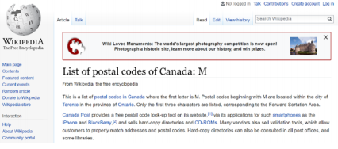
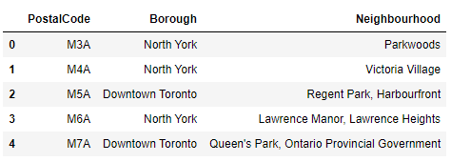
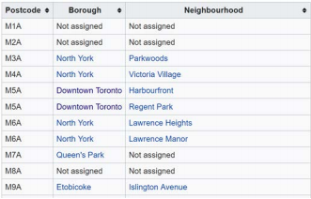
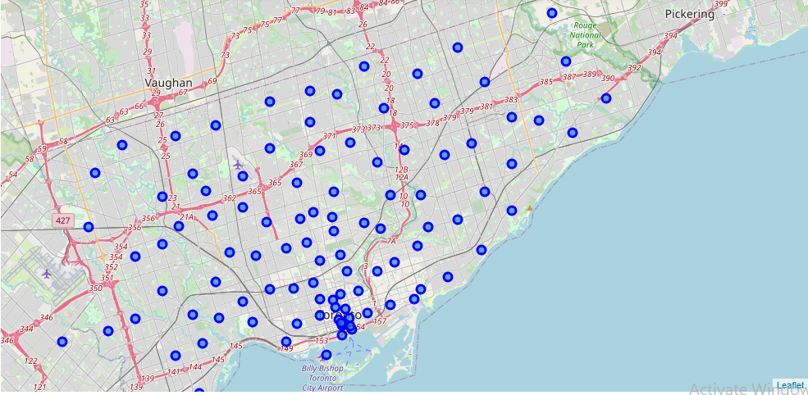
Methodology
Data Import and Processing
Neighborhood information get from Wiki
Neighborhood table/location after processing
https://en.wikipedia.org/wiki/List_of_postal_codes_of_Canada:_M

Slide 6
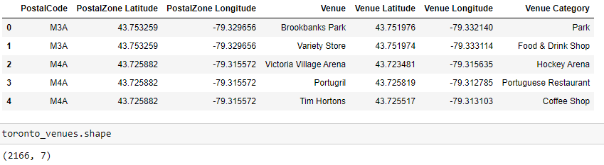
Methodology_Cont’d
Get Venues Information from Foursquare
Foursquare API utilized to obtain the venues for each neighborhood around the specific location
One hot encoding to create the data frame for analysis
A total of 277 unique venues/shops is listed

Slide 7
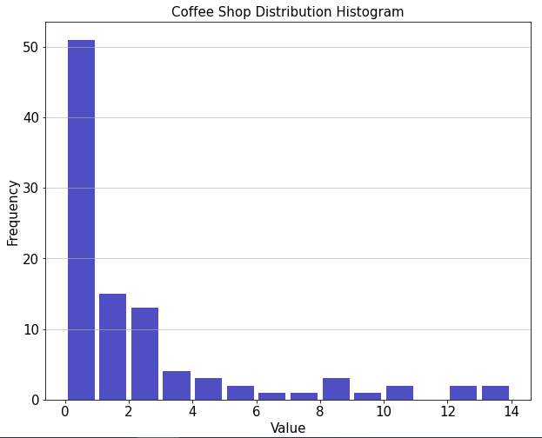
Methodology_Cont’d
Existing Coffee Shop Histogram
The chart shows the histogram of the existing coffee shops in Toronto
As it indicates, there are large number of neighborhoods which don’t have coffee shop
The dataset is splited into two sets:
The neighborhoods with coffee shops (used for model building)
The neighborhoods without coffee shops (used for candidate selection)

Slide 8
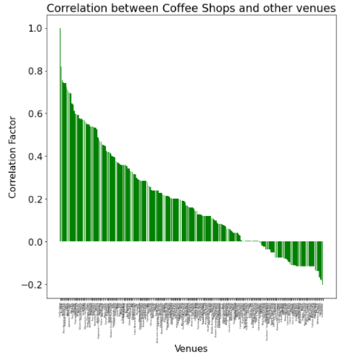
Methodology_Cont’d
Correlation Matrix
The chart shows the correlation between coffee shop numbers with the other venues
There are a total of 244 categories having correlation with coffee shops
For the purpose of simplification and negative correlation with some venues, all these venues are taken into account

Slide 9
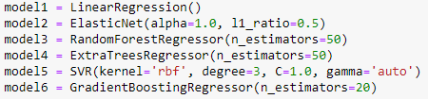
Methodology_Cont’d
ML Regression Models
6 Models are evaluated in order to have a higher confidence prediction
Training and Testing data split: 70/30

Slide 10
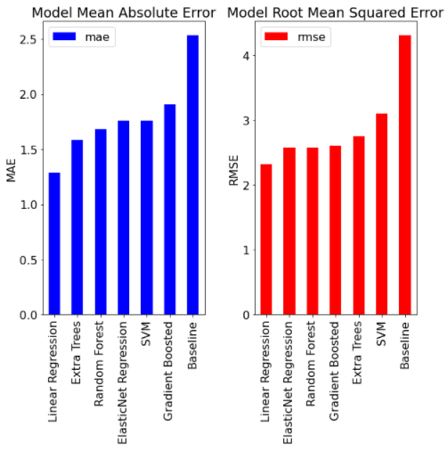
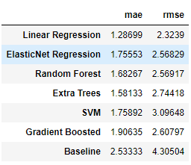
Results
MAE and RMSE utilized to compare the model accuracy
The evaluation shows that Linear Regression has the best accuracy

Slide 11
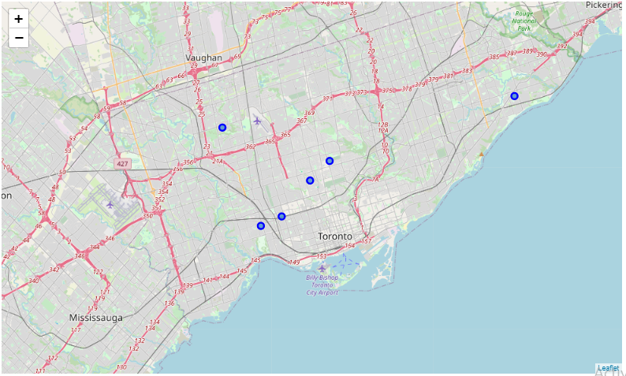
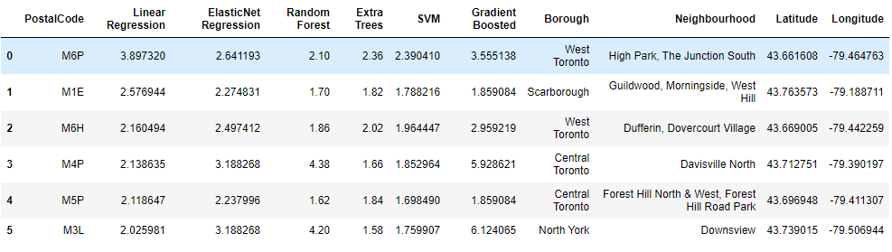
Discussion
Listing the best neighborhoods
The Best neighborhoods (top 6) are listed
Based on the commercial ecosystem, each of these neighborhoods is predicted to be suitable to have at least two coffee shops
The analysis provides a good insight for store location
Indeed, the best place to open a coffee shop should also taking into account time-lapse data of shops, rental, etc.

Slide 12

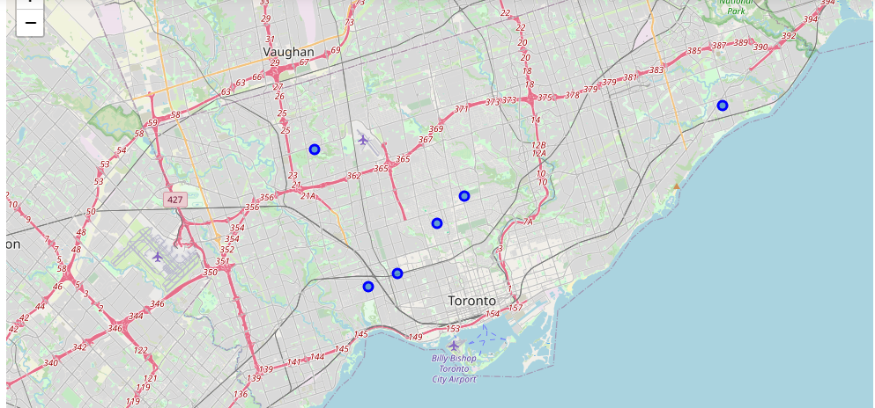
6 Best Neighborhood to Open a Coffee Shop

Slide 13
Conclusion
The project predicts the best neighborhoods to open a coffee shop in Toronto
Foursquare API is utilized to obtain all the venues in the neighborhoods
Multiple ML models (6 models) utilized to evaluate the predictions
Top 6 locations indicates good potential to open the coffee shop
Way Forward for Real World Location Selection:
More data should be incorporated, including time-lapse data of the shops, rental information, policy/government information, etc.
More detailed location analysis (block or street level)

Slide 14
Thank You
WZ
Capstone Project
Battle of Neighborhood
https://github.com/WendelZhao/Coursera_Capstone/blob/main/Battle_of_Neighborhoods.ipynb

